Slide 1
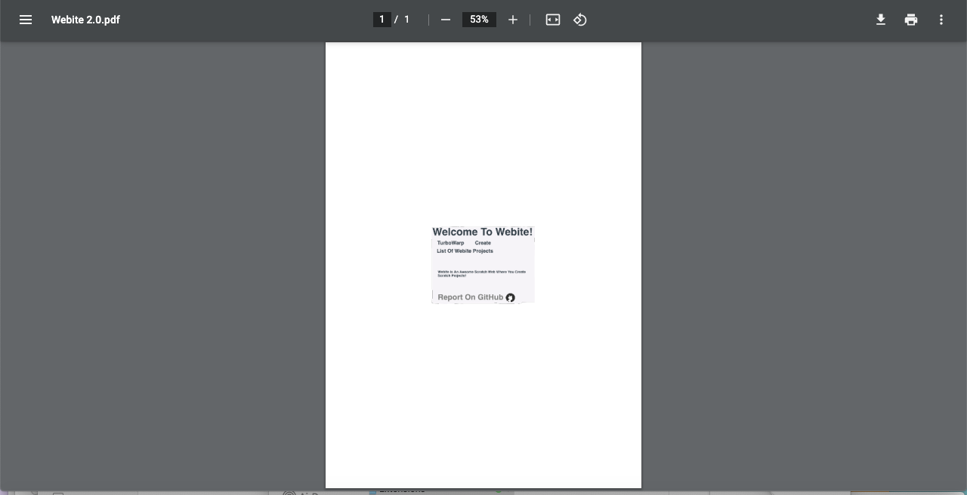
Webite Is A New Programming Language And Has Addons!

Slide 2
To Go To The Addons, Press The Black
And White 3 Dots

Slide 3
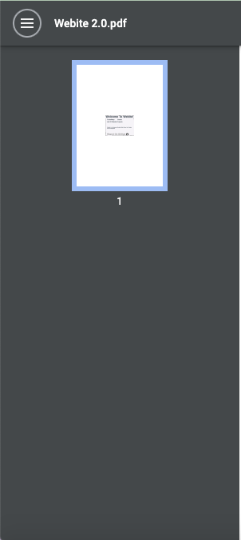
It Even Has Collasping Site Properties

Slide 4
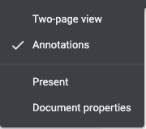
These Are The Addons

Slide 5
If You Just Want To Get Started In
Scratch 1.4, Use The .pdf File

Slide 6

The Only Supported Browsers Are Chrome, Safari And Microsoft Edge And Samsung Browser And Kiwi Browser, Firefox Will Fail!

Slide 7















You Can Upload Your Webite/TurboWarp Project To Scratch
And Share Them
Webite Is Compatible With All TurboWarp Extensions
Webite Is Awsome
Notes:
⚠️ Note That Scratch Is Not Compatible With TurboWarp Extensions

Slide 8
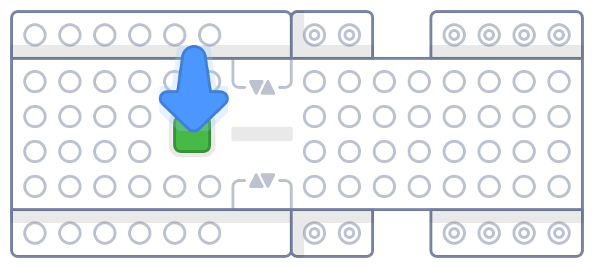

To Connect Us To Other Devices, Use Scratch Link, The Scratch App/TurboWarp App (Press Install App) Or Press
The Button

Slide 9

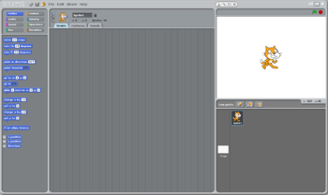

Preview:

Slide 10
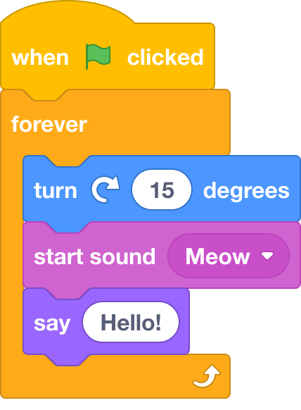
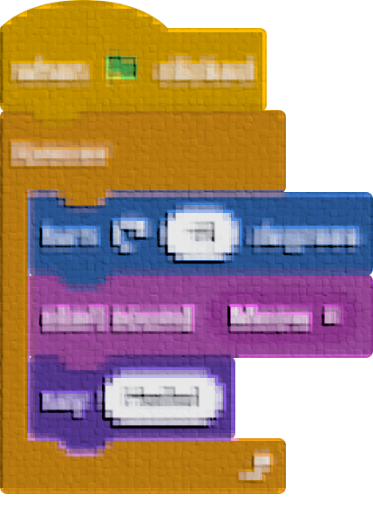
You Could Get A Script Like This:
It Will Look Like This On 8-Bit

Slide 11
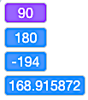
These Are
Scratch Variables

Slide 12
Unlike The Other 2D Styles, But This Is A 3D One

