Slide 1
How To Rotate A Sprite
On Webite

Slide 2
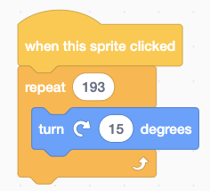
Use The Turn And Repeat Blocks

Slide 3
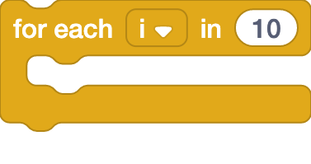
Use The For Each I In 10 Block

Slide 4
Reset Direction

Slide 5
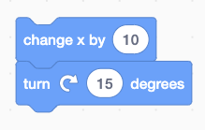
Turn While Moving

