Slide 1
How to Make A Catching Game
In Webite

Slide 2
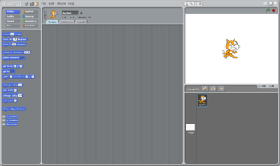
Add A Sprite

Slide 3
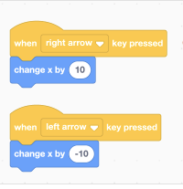
Arrow Keys

Slide 4
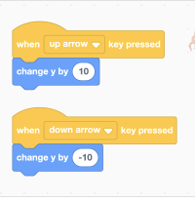
Up And Down Movement

Slide 5
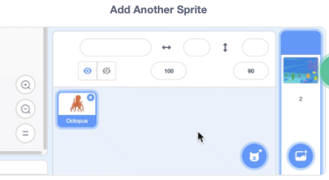

Slide 6
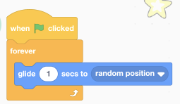
Glide

Slide 7
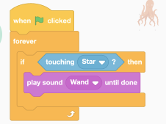
Tell Catcher It Is Catched

Slide 8
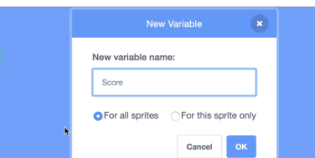
Create Score

Slide 9
